Slide 1
Family Tree Project
Paul van Sittert

Slide 2
Requirements
Create a menu based system that allows users to create and interact with a family tree.
Make use of linked lists and nodes for each family member.
Each family member has name, birthdate, spouse, sibling, first child variables.
Make use of id variables to identify family members
Order children by birthday.
Notes:
This project was a self designed project with the purpose of making use of classes and other functionality we have learnt in our lectures.
The project was to create a program that would allow users to create a family, with one person acting as the ancestor of this tree, and all others being that persons descendants (not including spouses).
Users would be able to add spouses to existing members, add children to existing members and output the family tree to screen, either in full or only a “nuclear” family, which refers to just parents and their children.
Functionality was later added to update an existing user.

Slide 3
Start
Exit
End
Initialize Family Tree and ancestor
Add Spouse
Loop through children and input new child based on age.
Display Self, Spouse and Children
Main Menu
Find Member By ID
Find Member By ID
Find Member By ID
Add Spouse
Add Child
Display Nuclear Family
Display Full Family
Starting at Ancestor
Display Self
Display Spouse
Call Display Sibling
Call Display Child
Notes:
An initial plan of the programs flow.
Users would start the program, and the program would set up the tree and prompt them for information on the ancestor which would be added to the tree.
Then users are presented with a menu where they can perform all the required actions to maintain the family tree.
Add spouse first asks the users for the id of a member to add the spouse to and uses a function to find that member, before gathering the spouses information and adding them to the member.
Add child performs similarly to start, but as children are stored in order from oldest to youngest, the program will loop through the list of children comparing their ages and placing the new child in the appropriate place
Display Nuclear family asks the users for the id of a member and uses a function to find that member before displaying their info, their spouses info and their childrens info.
Display full family makes use of a recursive function, starting at ancestor each member has their information displayed, alongside their spouse, and then call the function for their children before finally calling the function for their siblings.
Exit ends the program with an appropriate message.

Slide 4
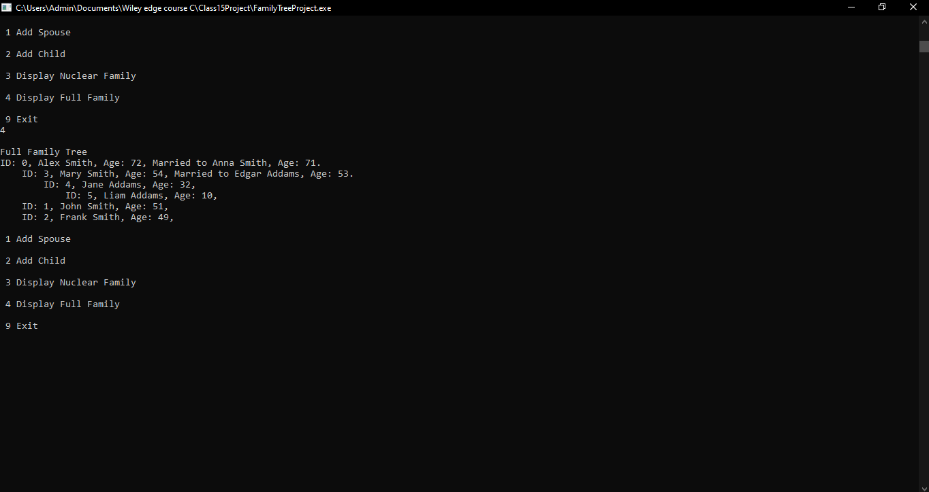
Example Display Family
Notes:
An example of the full family tree.
Each member’s information is displayed alongside their spouse if they have one.
Each member will have their information indented to showcase that the member in question is the child of the previous member, while members on the same level of indentation (on consecutive lines) are siblings.

Slide 5
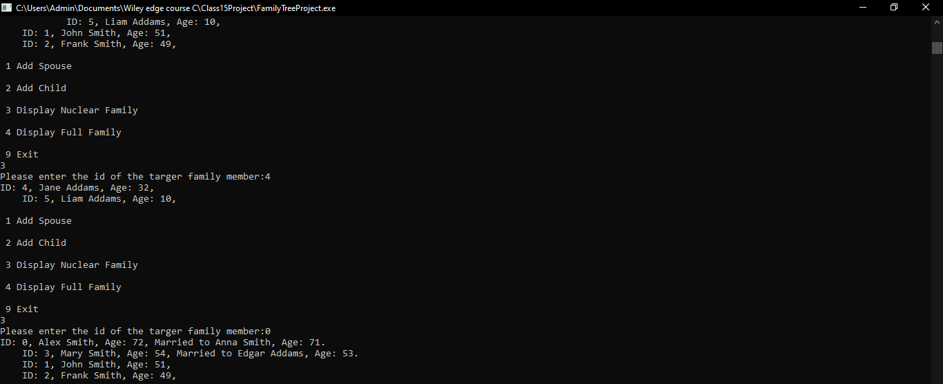
Example Display Nuclear Family
Notes:
An example of the display nuclear family function.
Displays the information of a section of the family tree.
A nuclear family refer to a small family unit of parents and their children, so that is what is displayed (Alongside the spouses of the children).

Slide 6
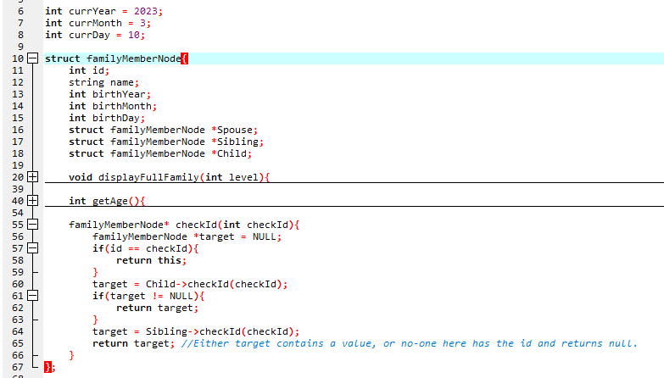
Family Member Node
Notes:
Family Member node
Contains all the information about each family member, a link to their spouse, a link to younger sibling and a link to their oldest child.
Has the function
displayFullFamily() a recursive function that displays the current Family members information, their spouses information, calls the function on their children and then on their siblings. Makes use of the int level, to add the appropriate indentation to their information. Children are given level+1 while siblings are given the same level as the older sibling.
getAge which returns the age currYear – birthYear. Will subtract 1 from age if the member hasn’t had their birthday yet this year.
CheckId another recursive function the checks if id is equal to input id, Calls the checkID function on their children then on their siblings. If none of them contain the input ID returns NULL, if one of them does contain the id, then that FamilyMemberNode will be returned.

Slide 7
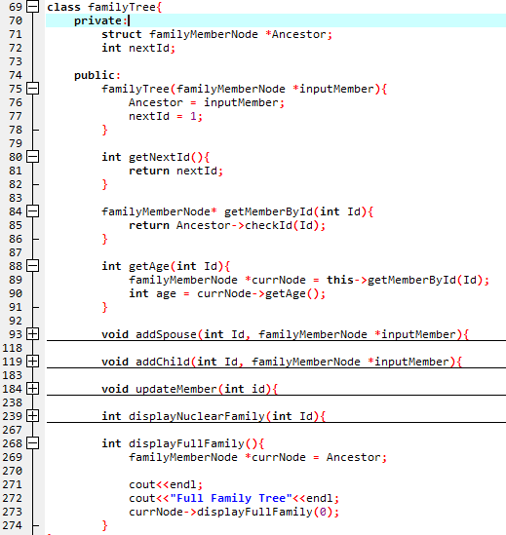
Family Tree Class
Notes:
The family tree class
Has the variables Ancestor, who is the family member at the head of the tree, and nextId which is the id to be used by the next descendant of Ancestor.
Some functionality will be explained on the following slides, but the smallest one will be explained here.
Has a constructor which takes a familyMemberNode as input, which will become the ancestor.
Has a getter of NextId.
Has a get memberById, which calls the recursive function checkId() on the ancestor. Returns the familyMemberNode of the family member with the input id.
Has the function getAge which calls the getAge function of FamilyMemberNode on the FamilyMember with the input id.
Has the function displayFullFamily() which calls the FamilyMemberNode recursive function displayFullFamily on the ancestor.

Slide 8
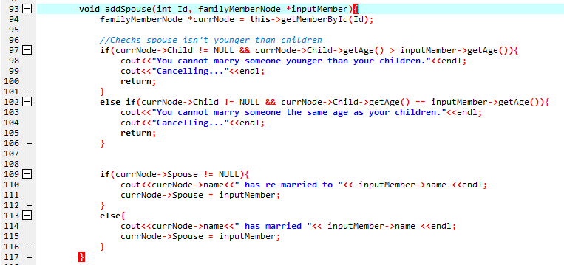
FamilyTree add spouse
Notes:
Add spouse
Uses Id to find the correct family member.
Make sure the input spouse is older than the existing children.
Checks whether the new spouse is replacing a previous spouse or is a new spouse, and displays an appropriate message.

Slide 9
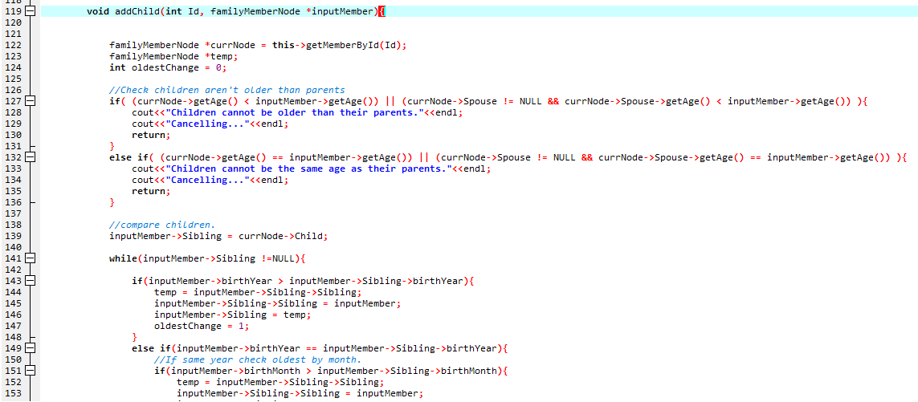
FamilyTree add child
Notes:
Add child
Uses Id to find the correct family member.
Makes sure that the input child is younger than both parents.
Makes input child -> sibling equal to Parents first child and loops checking if child is younger than their sibling. If they are swap them, else end the loop.
If the input child is oldest, ie oldestChange stays 0, then the Parents-> child is set to input child, else it is left as the input child has already been moved into the list by swapping.

Slide 10
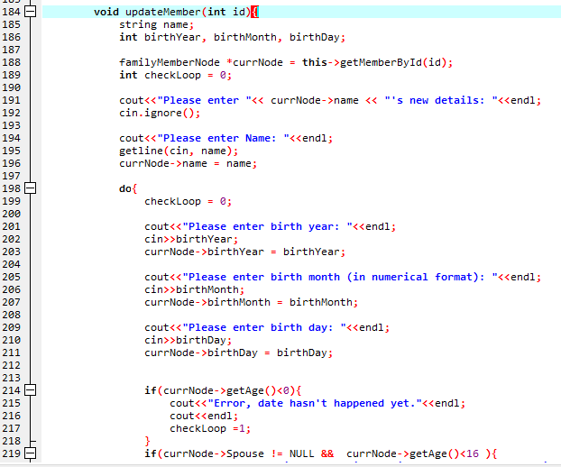
FamilyTree update
Notes:
Update
Using ID gets the correct family member.
Then allows users to input new information as if they were creating a new member.
However, due to the family member already existing and potentially having children or a spouse, a few more checks are included to make sure that
People under 16 aren’t married
Parents are older than their children
Birthdate is before current date.

Slide 11
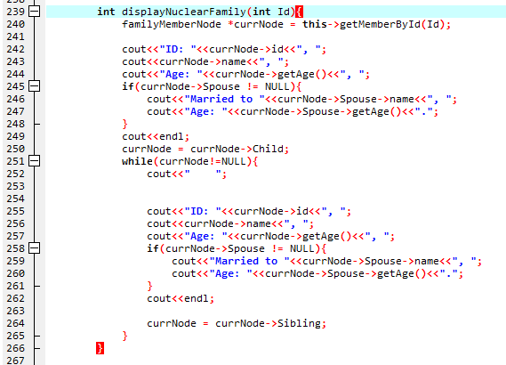
FamilyTree Display nuclear Family
Notes:
Display Nuclear family
Using id, finds the correct member and displays their information.
Loops through their children displaying their information.

Slide 12
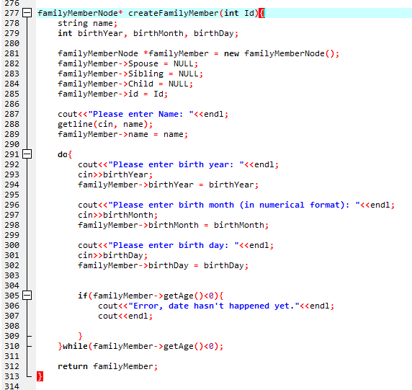
Create Family Member
Notes:
Create family member
Allows user to enter the information required to create a new family member
Has a do while loop to make sure users are born after the current date(which is currently a pre-set value).

Slide 13
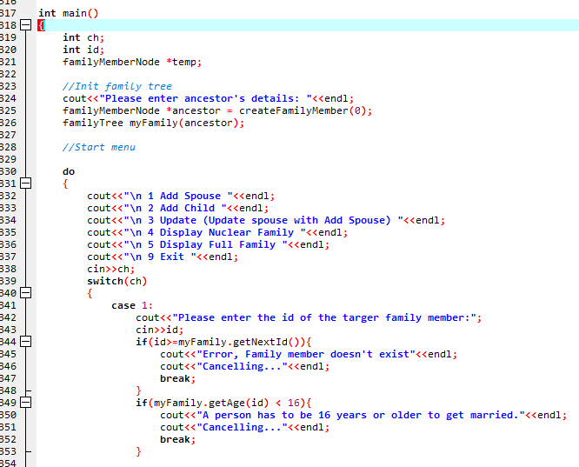
Main
Notes:
Main:
Starts with the initialisation of ancestor before using ancestor to create the familytree object.
A simple menu based system is displayed next where users can
Add spouse
Add child
Update member
Display nuclear family
Display full family
Exit
Each case calls the appropriate function, with only some minor checks to make sure data is appropriate.

